Slide 1
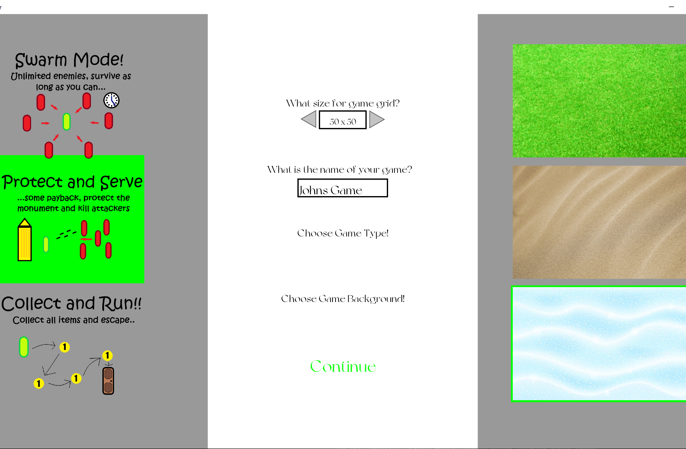
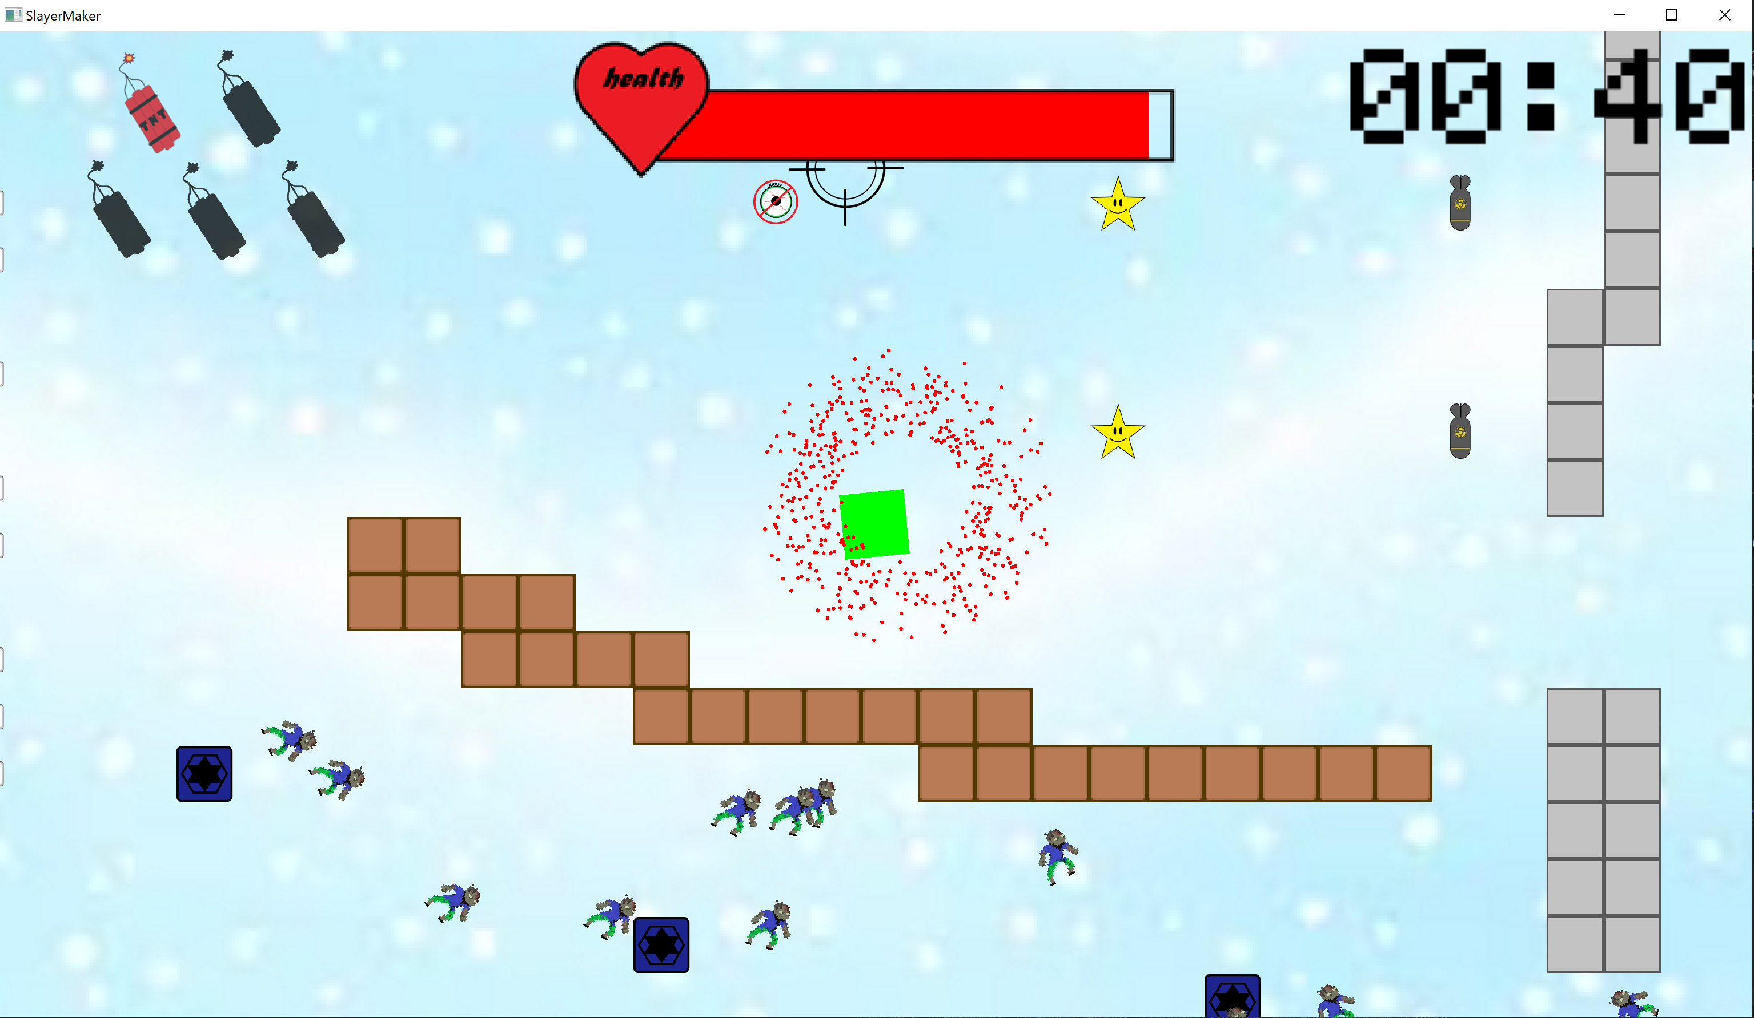
SlayerMaker 2D
My project is a no-code game editor built with C++ and the SFML graphics library. It enables people with no coding or programming experience to create 2D top-down “shoot-em-ups”.
My goal is to make game development more accessible to everyone.
-Seán Whelan

